Slide 1
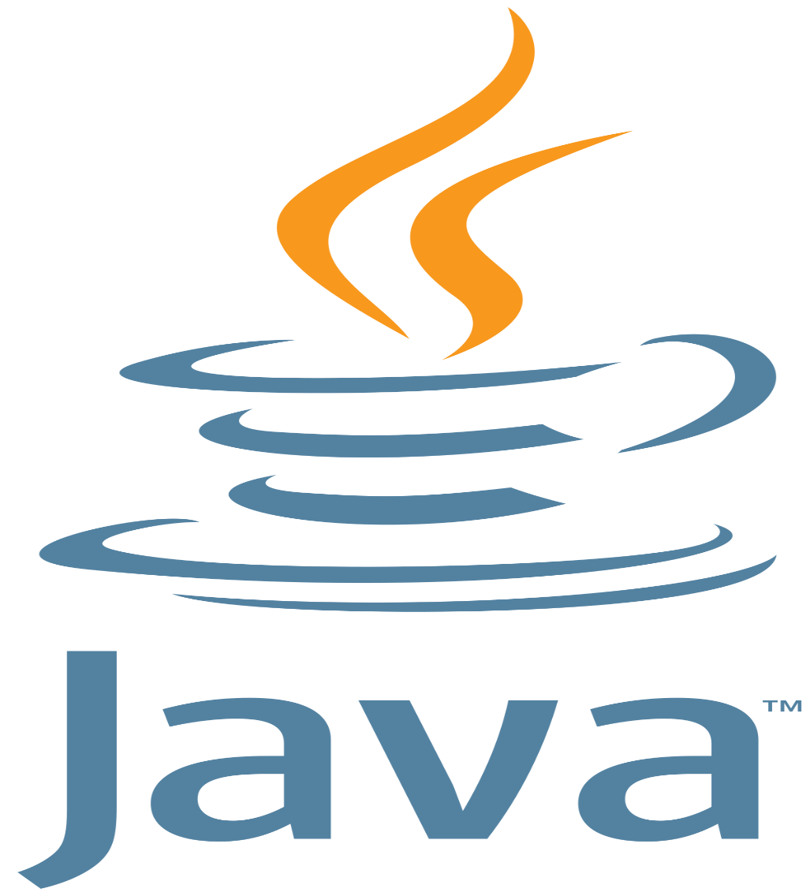
Introduction to Java
Shakir Hussain

Slide 2
Contents
What is Java?
Brief history of Java
The Java Programming Language
Buzzwords
The Java Platform
Development Environment Setup
First Java Program
Terminology

Slide 3
What is Java?
High level programming language
Originally developed by Sun Microsystems (now, Oracle), Which was initiated by James Gosling
Designed with a concept of write once and run anywhere
First version of java released in 1995
Initial name was Greentalk, later renamed to Oak and finally Java
Java is a Platform

Slide 4
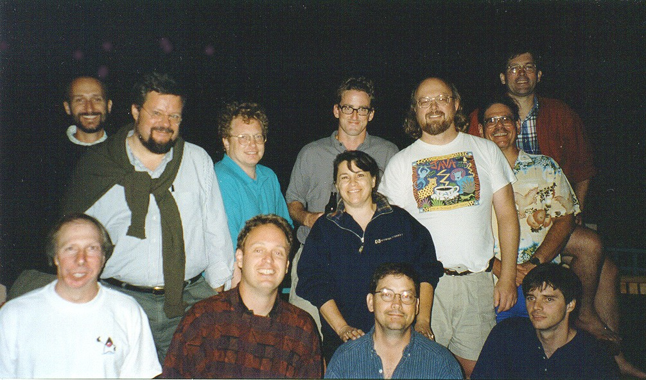
Brief history of Java
James Gosling
https://dzone.com/articles/a-short-history-of-java
https://www.javatpoint.com/history-of-java

Slide 5
The Java Programming Language

Slide 6
Java Language - Buzzwords
Platform Independent (architecture neutral)
Write once run anywhere
Simple
Small language, large libraries
Object Oriented
Supports Abstraction, Encapsulation, Polymorphism, Inheritance etc.

Slide 7
Java Language - Buzzwords..
Auto Garbage Collection
Memory management handled by Java Virtual Machine
Secure
No memory pointers, program run inside virtual machine
Java Bytecode verification
Array Index limit checking

Slide 8
Java Language – Buzzwords…
Portable
Primitive data type size and their arithmetic behavior are specified by the language.
Libraries define portable interfaces
Distributed
Libraries for network programming
Remote method invocation

Slide 9
Java Language – Buzzwords….
Multithreaded
Easy to create and use
Robust
Strong memory mgmt.
Dynamic
Finding runtime type information is easy.
The linking of data and methods to where they are located, is done at run-time.
New classes can be loaded while a program is running. Linking is done on the fly.

Slide 10
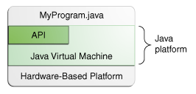
The Java Platform
Software-only platform that runs on top of other hardware-based platforms.
Environment in which java program runs.

Slide 11
Setup Dev Environment
What do you need to write and run java program?
Java Development Kit (JDK)
ASCII Text Editor

Slide 12
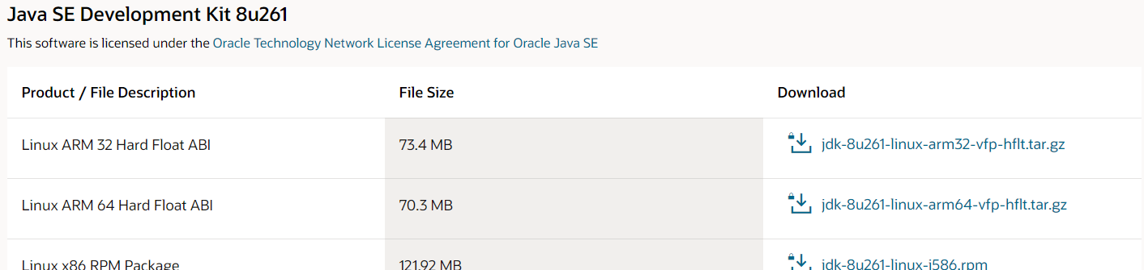
Download JDK
https://www.oracle.com/in/java/technologies/javase/javase-jdk8-downloads.html
Go to the below section, download platform specific installer

Slide 13
Install Steps
Once downloaded (e.g. Jdk-8u261-windows-x64.exe) , click to install.
Steps for windows JDK will be shown in next slides

Slide 14
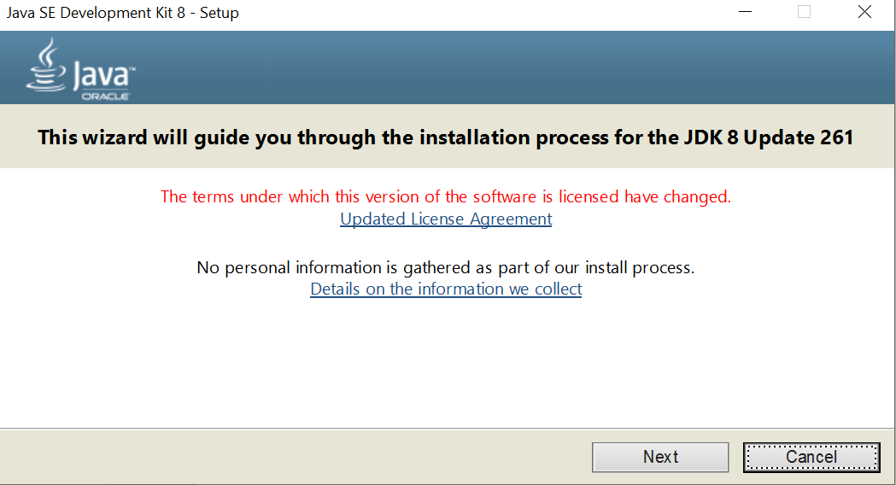
Install Steps – 1st Window

Slide 15
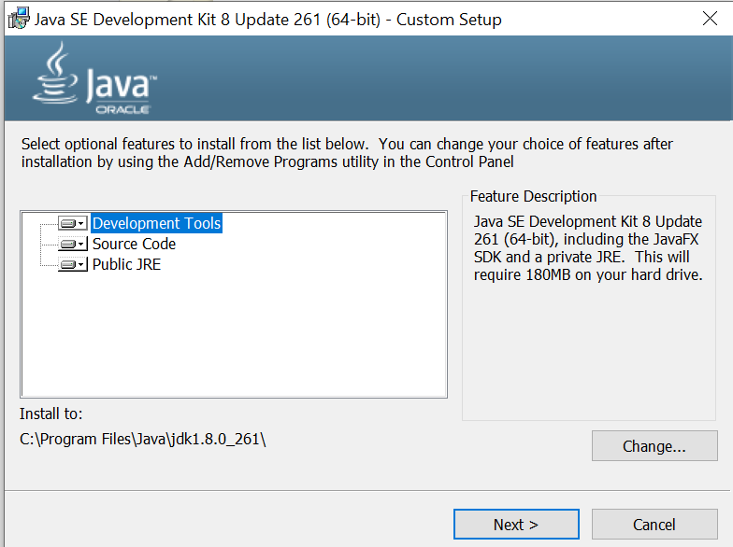
Install Steps – 2nd Window

Slide 16
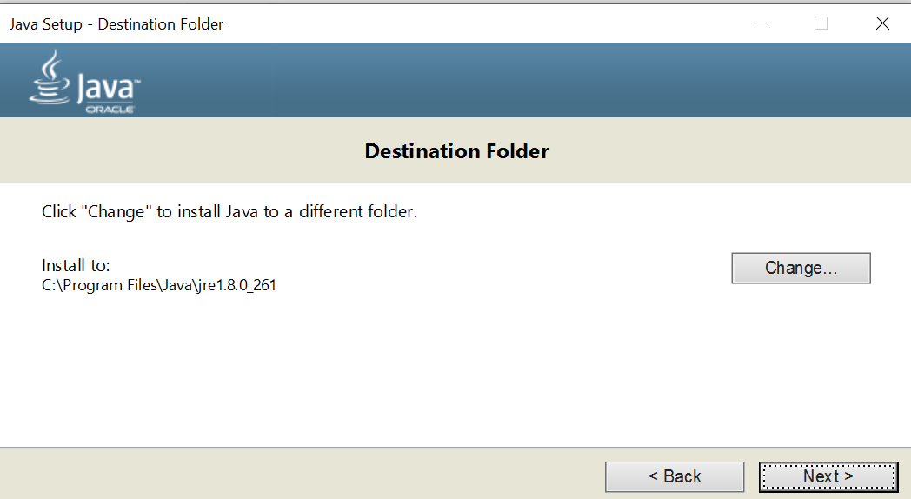
Install Steps – 3rd Window

Slide 17
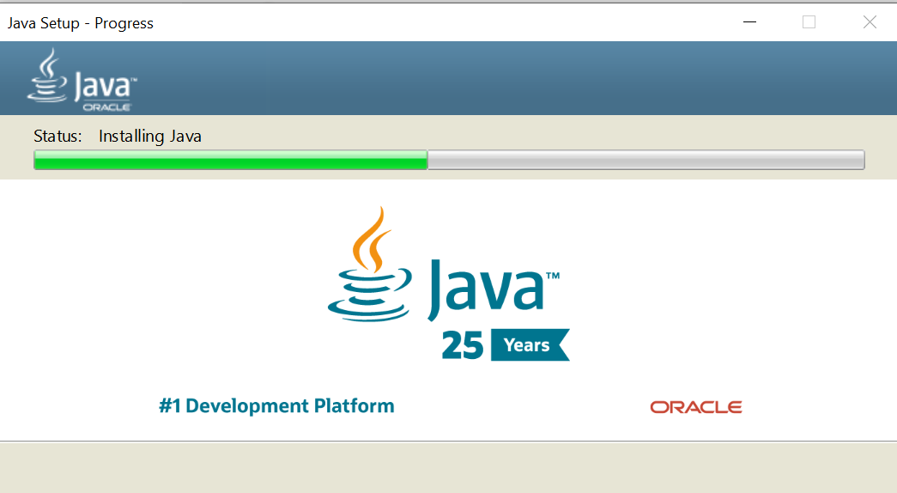
Install Steps - 4th Window

Slide 18
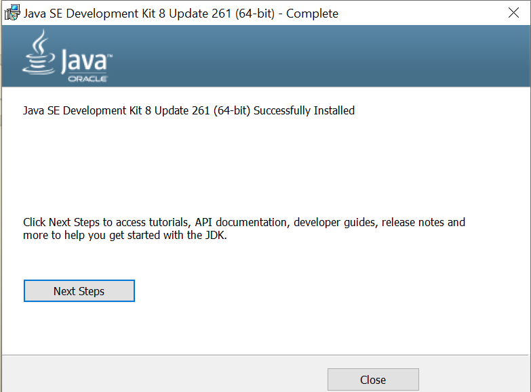
Install Steps – 5th Window

Slide 19
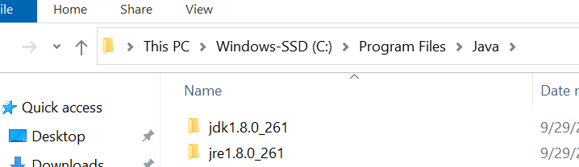
Setup
Verify JDK and JRE on your hard disc.
Now, Set the path environment variable as explained in next slide.

Slide 20
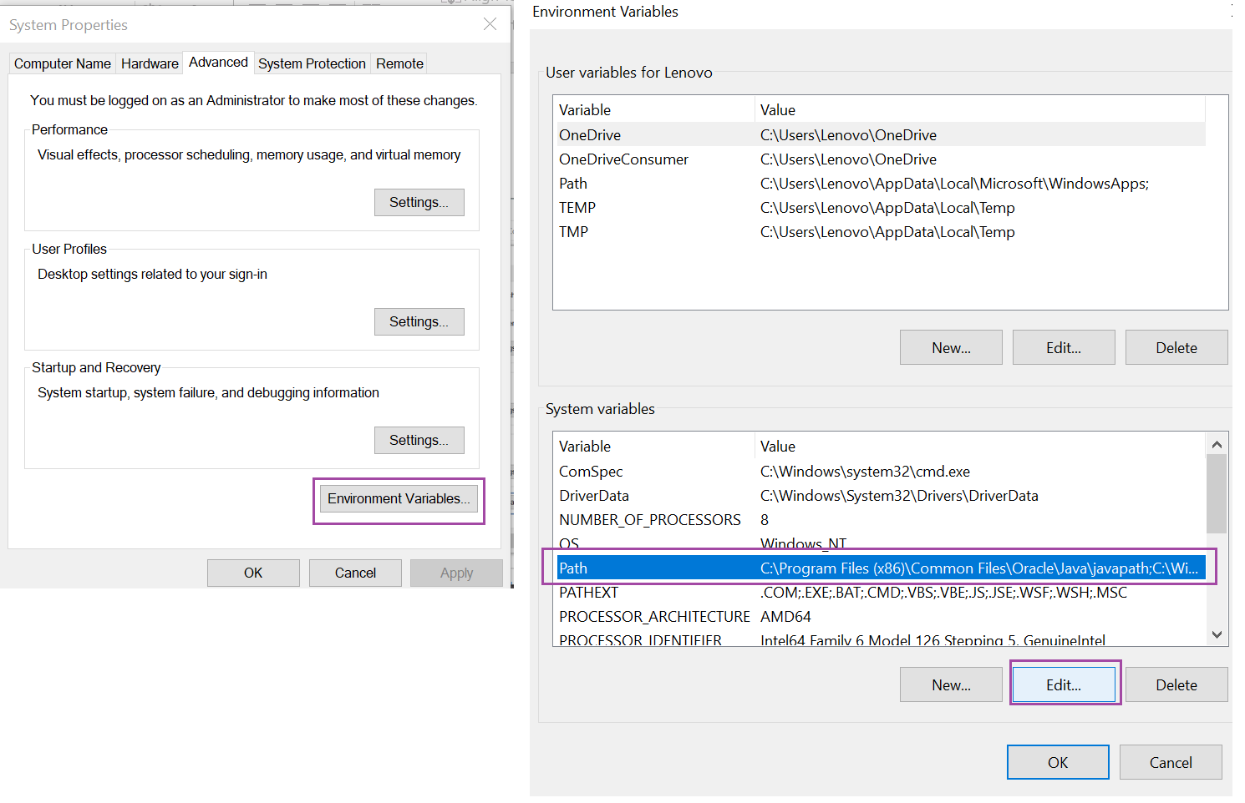
Setup..

Slide 21
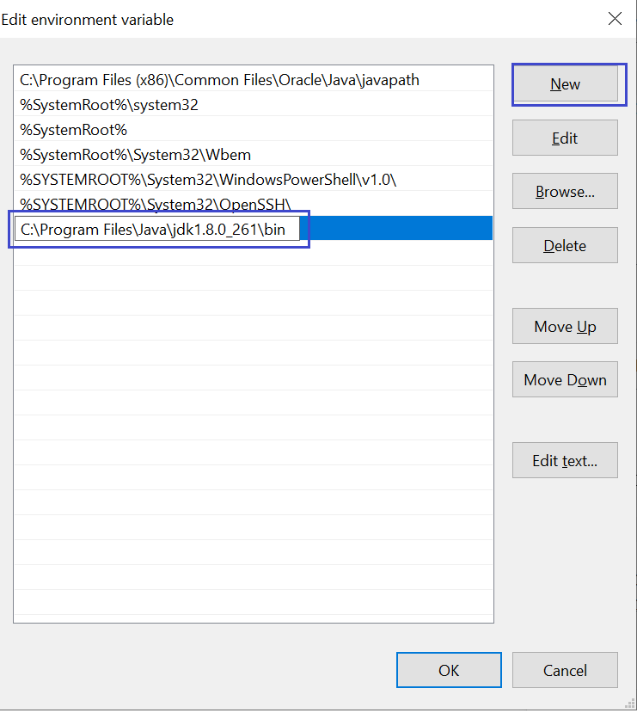
Setup…

Slide 22
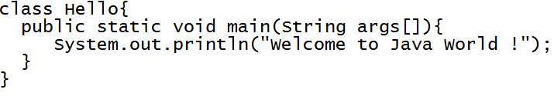
First Java Program
What do you need?
Java Development Kit (JDK)
A Text Editor
Open the notepad, write the following code and save the file as Hello.java (Let’s say file is saved as E:/test/Hello.java)

Slide 23
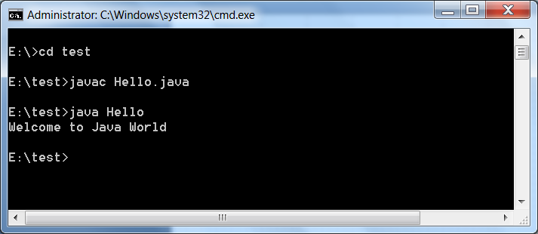
First Java Program
Now, open command prompt, change directory to the folder where you have saved your file.
Compile (javac Hello.java)
Run (java Hello)

Slide 24
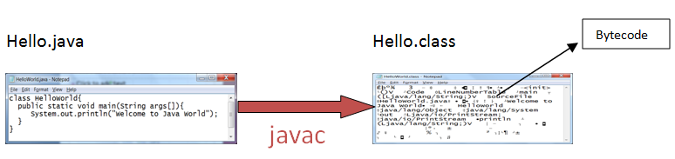
Java Environment
Compilation
Java Compiler translates the java source file into the class file
Class file contains bytecodes, the “machine language” of the java Virtual machine (JVM).
This java class file can run on any hardware platform and Operating System, which hosts JVM.

Slide 25
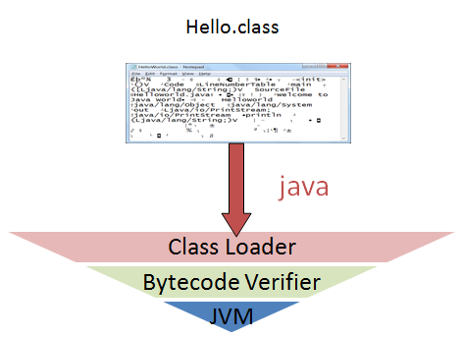
Java Environment
Class Loader
Class Loader loads class files into memory.
Class file can be loaded from local disc, network or over the internet

Slide 26
Java Environment
Bytecode Verifier
It verifies that the bytecodes are valid and safe.
Does not violate java security restrictions
Checks the internal consistency of the class and validity of the code

Slide 27
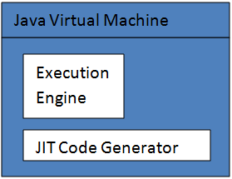
Java Environment
Java Virtual Machine
Translates the byte code into machine code depending upon the underling operating system and hardware combination. Which later executed by processor.

Slide 28
Java Terminology
JDK : Java Development Kit
All you need to develop, compile, debug and run your java program.
JRE : Java Runtime Environment
Subset of JDK
Includes Minimum Elements required to run java class file
Does not contain development tools like compiler, debugger etc.
JVM : Java Virtual Machine
Actually runs the java program and uses the library and other supporting files provided by JRE

Slide 29
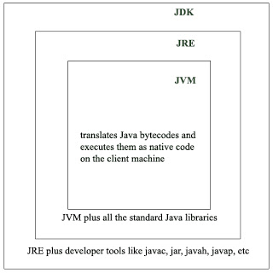
Java Terminology

Slide 30
Points to remember
Java Compiler, JVM .. All are platform dependent.
Only java class file (Bytecode) is platform independent.

Slide 31


